Slide 1
Communication in embedded systems
Week 7
Synchronization with Mutexes

Slide 2
What can go wrong with threads?
When multiple threads use the same variable, that variable can get an unexpected value

Slide 3
Basic synchronization problem
Concurrent access to shared variables may result in data inconsistency
Critical Section: piece of code accessing shared variables that must be protected against concurrent access
Mechanisms are required to ensure orderly execution of parallel threads with shared variables

Slide 4
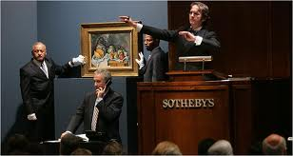
Synchronisation problem 1
Suppose we make an auction application
There could be a class Article, with
an attribute for the highest bid up to now
private int highestBid;
a method that changes highestBid when there is a higher bid:
public void newBid(int bid) { if (bid > highestBid) highestBid = bid; }

Slide 5
Synchronisation problem 1
What can go wrong?
Suppose
highestBid is now 10
2 bidders (in 2 threads) call method newBid at almost the same time, eg: newBid(14); and newBid(12);
Then, execution could go like this:
if(14>highestBid) if(12>highestBid) highestBid = 14; highestBid = 12;
Result: highestBid is 12, and not 14

Slide 6
Synchronisation problem 1
Reason:
context switch between threads can occur between test (bid>highestBid) and block (highestBid=bid;) of the if-statement
Solution:
make sure that at most one thread at a time can call this method
Same kind of problem can occur within one single statement (see next slide)

Slide 7
Synchronisation problem 2
Suppose int count=5 is shared between 2 threads
One thread does count++ and the other does count—
both at the same time
Expected result: 5
count++ could be implemented as
❶ register1 = count; ❷ register1 = register1 + 1; ❸ count = register1;
count-- could be implemented as
❹ register2 = count; ❺ register2 = register2 – 1; ❻ count = register2;
Consider this execution interleaving: ❶ ❷ ❹ ❺ ❸ ❻
Result?
?
count++ is a "non-atomic operation"
Notes:
Can be emulated in code with sleep() or wait() inbetween commands.

Slide 8
Non-atomic actions
Most statements consist of several steps
Steps can be interleaved with other threads
This is called non-atomic
Such statements are not thread-safe

Slide 9
Effect of the compiler
Suppose we have this code:
int i; int count = 0; for (i=0;i<100000;i++) { count++; }
No optimization:
Behavior is like described before: for (i=0;i<100000;i++) { register = count; register = register + 1; count = register; }
Mild optimization:
Value read from memory once register = count; for (i=0;i<100000;i++) { register = register + 1; } count = register;
Aggressive optimization:
For-statement completely eliminated register = count; register = register + 100000; count = register;

Slide 10
Volatile variables
We can make a variable volatile
volatile int count = 0;
This means that the compiler will assume that the value of the variable in memory can change at any moment
Before any operation, the value will be fetched from memory
Apply this to:
Variables that are used by multiple threads
Variables that are used by threads and ISR’s
IO data registers

Slide 11
Synchronizing threads with Mutex
For synchronizing non-atomic statements, we can use a “Lock”; also called “Mutex”
“Mutex” is short for “Mutual Exclusion”
A Mutex can be acquired by at most one thread
Use it to make sure that only one thread at a time can access a variable
When 2 or more threads compete to acquire the same Mutex:
The first thread will succeed
Later thread(s) must wait until the first one releases the Mutex
For that, every Mutex has a waiting queue for threads

Slide 12
How to use a Mutex
mutex_id refers to a specific Mutex (must be created earlier)
In CMSIS, we can use a Mutex as follows:
osMutexAcquire(mutex_id, osWaitForever); if (bid > highestBid) highestBid = bid; osMutexRelease(mutex_id);
Timeout value
How long we wait to acquire Mutex
0 → method returns instantly
osWaitForever → wait until Mutex is acquired, no matter how long it takes
Any other value → wait a specific nr of timerticks

Slide 13
When to use a Mutex?
Use a Mutex when a shared variable can be changed by multiple threads at the same time
Mutexes have some drawbacks:
Extra code involved, so takes more execution time
Extra waiting is introduced because of the mutex
Therefore, Mutexes should be used with care

Slide 14
Some details
Mutexes are reentrant
Mutexes use priority
Mutexes apply priority inheritance

Slide 15
Mutexes are re-entrant (recursive)
When a thread has acquired a Mutex, same thread can acquire that Mutex again
This means that a Mutex is “re-entrant” or “recursive”
Example:
Mutex must be released as often as it was acquired
osMutexAcquire(mutex_id, osWaitForever); if (bid>highestBid) highestBid = bid; showBid(highestBid); osMutexRelease(mutex_id);
private void showBid(int bid) { osMutexAcquire(mutex_id, osWaitForever); ...... osMutexRelease(mutex_id); }

Slide 16
Mutexes have an owner
A Mutex “remembers” which thread acquired it
Only the same thread can acquire it again
The thread must release the Mutex
Therefor: Mutexes can not be used in ISR

Slide 17
Mutexes use priority
When multiple thread are blocked on a Mutex, and it is released by another thread:
The thread with the highest priority will be unblocked
If there are multiple threads with that priority, the one that has been waiting the longest will be unblocked
Consequence:
Threads with low priority might have to wait very long
That’s why we must define a timeout value

Slide 18
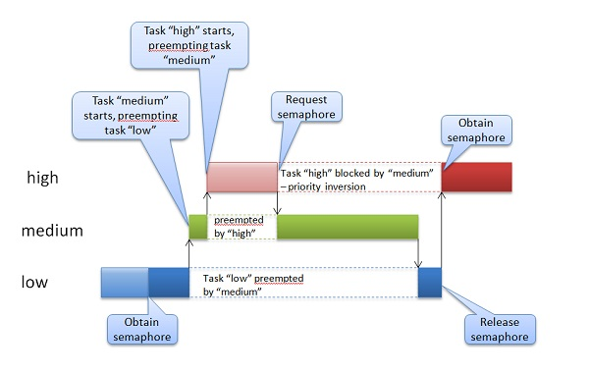
Priority inversion
With Mutexes, it is possible that a low priority thread blocks a high priority thread
This is called “priority inversion”, and is undesired
To solve that problem, the priority of the “low” thread is temporarily raised to that of the “high” thread → priority inheritance
This problem occurred on the Mars Pathfinder in July 1997

Slide 19
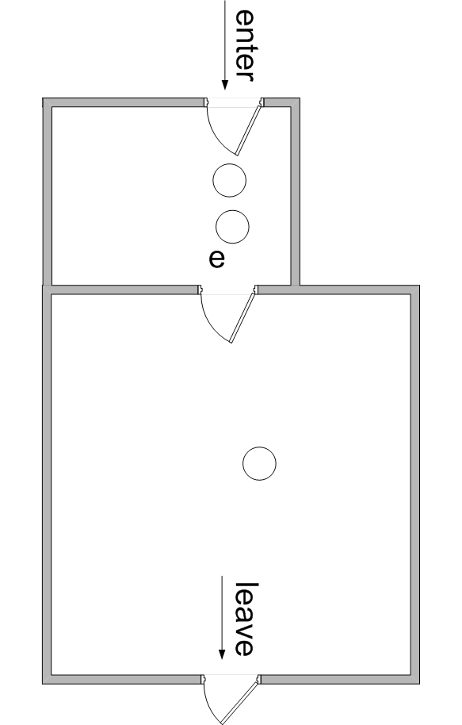
Dentist analogy (I)
Compare with dentist practice
There is a treatment room (t), where at most one patient can be
There is a waiting room (e) for patients that just came in
t

Slide 20
Pros & Cons for Mutex
Pros
Easy to use
A good solution in many cases
Cons
Can not be used from ISR’s
Not good for every situation

Slide 21
Assignment 5
Extend your program to also receive data from the PC
Each character received by the device must be increased and sent back to the PC; e.g.:
When the user types ‘4’ on the PC, your device must return ‘5’
When the user types ‘d’ on the PC, your device must return ‘e’
Do this again in 2 ways:
Use the “normal” Serial library to receive/send data from/to your PC
Receive/send the same data without using Serial, but by directly accessing the UART registers (UDR, UCSR, UBRR)
Try out how much you can change the baud rate before you start getting errors
Make sure that you can explain clearly
How you initialized the UART
How receiving and transmitting works

